Slide 1
Good Academic Practice
Prof. Graeme Ruxton
Academic Misconduct Officer for
School of Biology
gr41@st-andrews.ac.uk

Slide 2
Objectives of this Lecture
To make sure that you understand what Good Academic Practice is
To try to ensure that we do not meet in my capacity as A.M.O.
Good Academic Practice avoids charges of Academic Misconduct

Slide 3
Avoiding Academic Misconduct is important
We need to properly evaluate your understanding
We need to maintain the integrity of our degrees
Science (and research in general) is built on trust – we trust the honesty of other researchers.

Slide 4
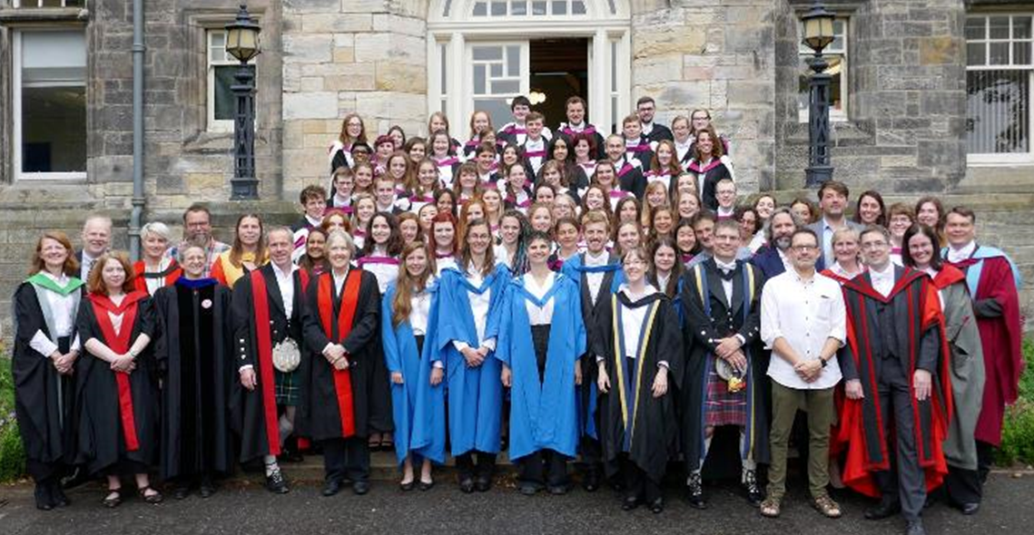
You are glad that we are vigilant for Academic Misconduct
We reward students fairly
We correctly identify your weaknesses so we can help you correct them
We train you in appropriate academic conduct early in your career, so you are not hampered later
We maintain the integrity of your degree

Slide 5
Forms of Academic Misconduct
Plagiarism
Multiple Submission
Falsification
False Citation
Misconduct in Exams or Class Tests
Aiding and Abetting
Coercion
Contract cheating
University of St Andrews, Good Academic Practice Policy
Notes:
https://mms.st-andrews.ac.uk/mms/unit/40SCBIOL/AcademicMisconduct
Plagiarism: You have been issued a Written Warning over Academic Misconduct, for Plagiarism in <item of work>
Multiple Submission: You have been issued a Written Warning over Academic Misconduct, for Multiple Submission in <item of work>
Falsification: You have been issued a Written Warning over Academic Misconduct, for Falsification in <item of work>
False Citation: You have been issued a Written Warning over Academic Misconduct, for False Citation in <item of work>
Misconduct in Exams: You have been issued a Written Warning over Academic Misconduct, for Misconduct in Exams/Class Tests in <item of work>
Aiding and Abetting: You have been issued a Written Warning over Academic Misconduct, for Aiding and Abetting in <item of work>
Coercion: You have been issued a Written Warning over Academic Misconduct, for Coercion in <item of work>
Contract Cheating: You have been issued a Written Warning over Academic Misconduct, for Contract cheating in <item of work>

Slide 6
Forms of Academic Misconduct
Multiple submission: the act of submitting for assessment a piece of work already (or simultaneously) submitted for assessment.
False citation: the citing of a source for information, when the source does not contain that information or when the information cited was not gleaned from that source.
Falsification: the fabrication or alteration of data.
Aiding and abetting: any form of assistance with another person’s academic misconduct.
Coercion: where a student puts pressure on another student or member of staff to act in a particular way, or attempts to do so, with the intention of gaining an academic advantage.
University of St Andrews, Good Academic Practice Policy

Slide 7
Plagiarism
Plagiarism: the act of taking another’s ideas and representing them as one’s own.
(Notice – not just “words” but “ideas”
A piece of work that contains plagiarised material may be subject to a penalty even if there were no intention to plagiarise.

Slide 8
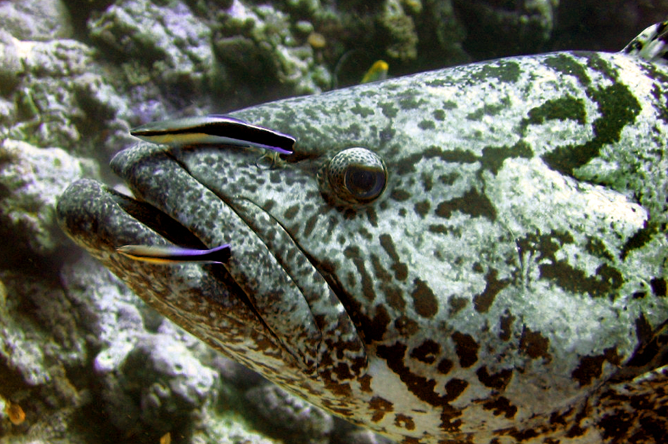
What constitutes Plagiarism? An example
Rohde, K. (1982). Ecology of Marine Parasites.
The incidence of ‘cleaning behaviour’ by marine fish species is a widespread phenomenon in tropical and temperate marine waters. Cleaning is sometimes initiated by the cleaner animal, sometimes by the host fish (Potts 1968, Losey 1971).
The above sentences are written by Rohde in his own words. They do not appear in either reference [neither Potts (1968) nor Losey (1971)].
Rohde is synthesising the ideas from two sources but is not claiming intellectual ownership of the idea. That ownership is attributed to the references.
Source: en.wikipedia.org

Slide 9
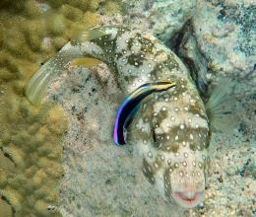
What constitutes Plagiarism? Some examples:
ORIGINAL:
The incidence of ‘cleaning behaviour’ by marine fish species is a widespread phenomenon in tropical and temperate marine waters.
SOME USES:
The incidence of ‘cleaning behaviour’ by marine fish species is a widespread phenomenon in tropical and temperate marine waters.
“The incidence of ‘cleaning behaviour’ by marine fish species is a widespread phenomenon in tropical and temperate marine waters”.
“The incidence of ‘cleaning behaviour’ by marine fish species is a widespread phenomenon in tropical and temperate marine waters” (Rohde 1982).
The occurrence of cleaning behaviour and host specificity amongst a range of species of marine fish is discussed in detail by Rohde (1982).
Misconduct
Misconduct
Source: en.wikipedia.org
Poor Practice
Proper citation is essential
Good Practice

Slide 10
Avoiding plagiarism
In the process of writing NEVER EVER be tempted to cut and paste information or text from other documents or webpages into your work – including teaching materials - even if the intention is to rewrite it in your own words later.
There is a real risk that you forget to do so or forget which bits of the document are your own words or those of another writer.
You can’t over-cite, always acknowledge others work.

Slide 11
Avoiding plagiarism
Campbell is NOT
the only book on biology
If you only use a single
Source, avoiding plagiarism
Is harder

Slide 12
Cheating in exams or class test
Taking electronic devices, software or materials into an examination venue (other than those specifically permitted), irrespective of whether or not any use of the item(s) was made.
Taking information into an examination venue (including toilets etc), except where such items are left in an area designated by an invigilator, irrespective of whether or not any use was made of the item(s)
Providing University staff with incorrect or misleading information related to the examination
Unauthorised removal of an examination script, papers or blank examination stationery from the examination hall
Unauthorised exit from the examination hall during the period of an examination
Unauthorised acquisition of examination questions prior to an examination, whether or not the student is a candidate for that examination.
Failure to follow the rules for an examination, in a way that might result in the gaining of an academic advantage.
University of St Andrews, Good Academic Practice Policy
Notes:
Taking information (including notes in any format, books, electronically stored data or illegitimately annotated copies of dictionaries, set texts, annotations made on or concealed on parts of a student’s body, etc) into an examination venue (including toilets etc), except where such items are left in an area designated by an invigilator, irrespective of whether or not any use was made of the item(s)

Slide 13
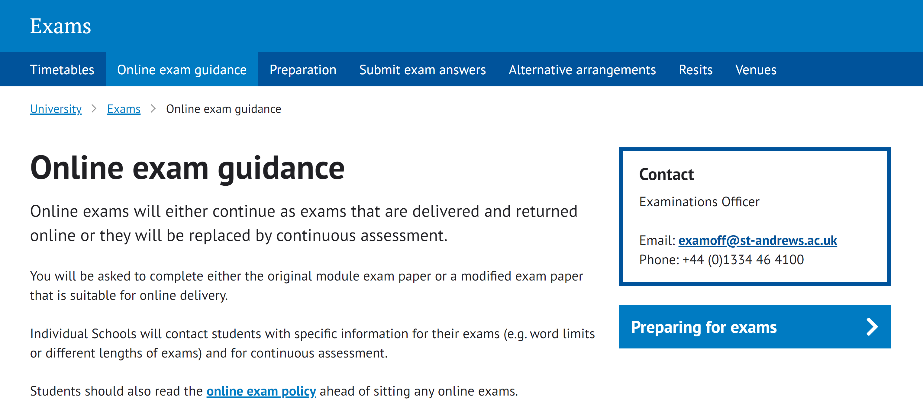
Cheating in exams – working from home
There is guidance on this at https://www.st-andrews.ac.uk/exams/remote-exams/
Avoid copying directly from any online source
University of St Andrews, Good Academic Practice Policy
Notes:
Taking information (including notes in any format, books, electronically stored data or illegitimately annotated copies of dictionaries, set texts, annotations made on or concealed on parts of a student’s body, etc) into an examination venue (including toilets etc), except where such items are left in an area designated by an invigilator, irrespective of whether or not any use was made of the item(s)

Slide 14
Cheating in exams – working from home
Online exam policy https://www.st-andrews.ac.uk/policy/academic-policies-assessment-examination-and-award-examination-rules/online-examination.pdf
University of St Andrews, Good Academic Practice Policy
Notes:
Taking information (including notes in any format, books, electronically stored data or illegitimately annotated copies of dictionaries, set texts, annotations made on or concealed on parts of a student’s body, etc) into an examination venue (including toilets etc), except where such items are left in an area designated by an invigilator, irrespective of whether or not any use was made of the item(s)

Slide 15
Contract cheating
Contract cheating: where a student commissions or seeks to commission another party (either paid or unpaid) to perform academic work on their behalf.
University of St Andrews, Good Academic Practice Policy
Notes:
Even asking a friend, family member, or another individual to complete any aspect of assessed work is considered as contract cheating as a student is contracting that work out to a third party to complete it on their behalf.

Slide 16
Contract cheating
Asking your flatmate to edit your essay for improved grammar and spelling.
Misconduct
Asking your flatmate to read over your essay and highlight mistakes in spelling and grammar.
Good Practice
Asking your flatmate to edit your essay for improved structure.
Misconduct
Prior to starting your essay, asking a classmate if you can read their essay on the same topic and use their sequence of ideas.
Misconduct

Slide 17
Contract cheating
Using an internet company to improve the structure of your essay for a fee.
Misconduct
Using an internet company to provide you with a complete essay for a fee; you submit the essay in an unchanged form.
Misconduct
Using an internet company to provide you with a complete essay for a fee; which you modify substantially before submitting.
Misconduct
If someone helps you – acknowledge and describe that help

Slide 18
Watch out – you can plagiarism teaching materials just like any other source
The Good Academic Practice Handbook is quite explicit that plagiarism
“may involve the use, without proper acknowledgement, of published or unpublished work, of work done partly or wholly by another person, of work obtained from an essay bank or a web site, or of recorded material from lectures and tutorials” (emphasis added).

Slide 19
Changing some words using a thesaurus – but maintaining the structure and ideas of the original without proper attribution is still plagiarism
If you wanted to write an essay about non-visual camouflage then you would find a paper by me on that – if your essay ends up using the same headings as my article then you need to explain clearly that you have adopted my high-level structure in your essay to avoid plagiarism.
If my paper lists four criteria that need to be satisfied for an organism to be exhibiting non-visual crypsis and you want to include there criteria in your essay then you need to attribute the ideas contained in these criteria to me – even if your description of each criteria is re-expressed in your own words.
Thus to avoid plagiarism you really want to
digest material thoroughly before re-expressing that material in your own way and in your own words
Draw from multiple sources
Attribute ideas as well as exact quotes

Slide 20
We don’t obsess about trivial commonalities
In an essay on Large African Carnivores – we might both write “Of the three large African predatory cats, the lion has the most complex social structure”, and this sentence might even occur in a textbook.
This commonality on its own does not constitute plagiarism – it is a single commonplace sentence. It is plausible that you, me and the author of the textbook all independently formed this sentence in our own heads.
But the greater the extend of the similar or identical material – and the less-commonplace the material the less plausible this explanation becomes.
“The collaborative sisterhoods of lions finds no parallel in the more insular lives of leopards and cheetahs.” is less commonplace

Slide 21
If in any doubt about whether anything you are doing is poor practice or misconduct then get clarification from the module organiser or me.
Ignorance is never a defence – so always ask – and we want to guide you towards good academic practices – so we are glad you asked.

Slide 22
What happens if Misconduct Occurs
All possible cases reported to be by marker
I decide if I feel there has been misconduct or simply poor academic practice.
If it is the latter I will write to you informally with advice but no official action will be taken
Otherwise the university’s procedures are followed (find these in the documentation)
Wide range of outcomes – but remember we are an educative establishment, we want to help our students educate themselves

